Slide 1
The Role of OSI Model in Software-Defined Networking(SDN)
CSA0714-Computer Networks
Presented By:
Sri Janani B(192421036)

Slide 2
Introduction to OSI Model and SDN
What is the OSI Model?
The Open Systems Interconnection (OSI) model is a 7-layer networking framework.
It standardizes communication between different network devices.
Each layer performs a specific networking function.
What is SDN?
Software-Defined Networking (SDN) separates the Control Plane from the Data Plane.
The network is managed by a centralized SDN Controller.
SDN provides flexibility, automation, and easier network management.
Key Point:
The OSI model provides the communication framework, while SDN modernizes how networks are controlled.

Slide 3
OSI Layers and Their Role in SDN
OSI Layer | Role in SDN
Application | Network applications communicate with the SDN Controller.
Presentation | Data formatting and encryption.
Session | Maintains communication sessions.
Transport | Provides reliable data transmission using TCP/UDP.
Network | SDN Controller manages routing decisions.
Data Link | OpenFlow switches forward packets.
Physical | Hardware devices transmit data.
Highlight:
SDN mainly impacts the Network Layer while utilizing all OSI layers.

Slide 4
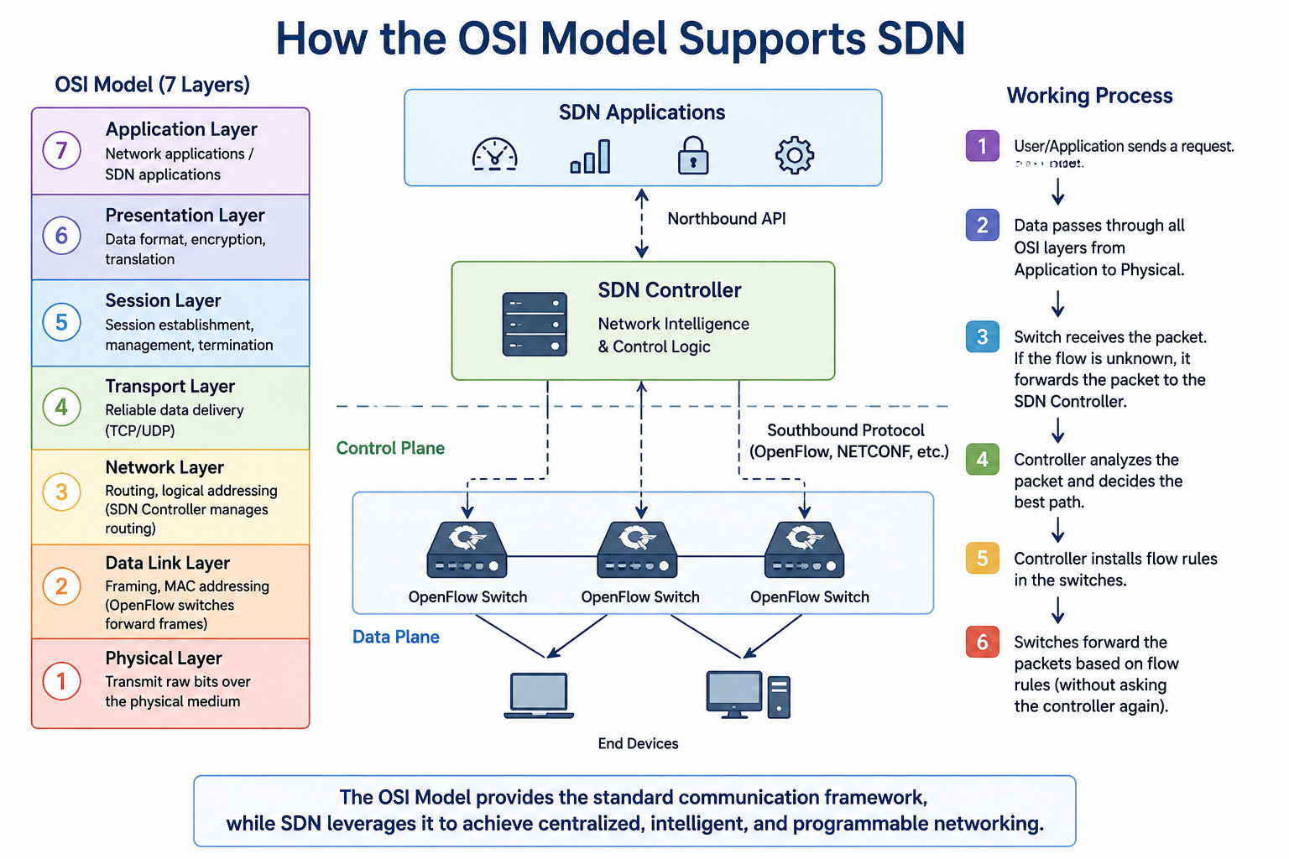
How the OSI Model Supports SDN

Slide 5
Benefits of Using OSI Model in SDN
Advantages
Better network management
Improved security
Easy troubleshooting
Vendor interoperability
Efficient traffic engineering
Faster deployment of services
Real-World Applications
Cloud Computing
Data Centers
5G Networks
Internet of Things (IoT)
Enterprise Networks

Slide 6
Challenges and Future Scope
Challenges
Controller failure can affect the network.
Security attacks targeting the controller.
Migration from traditional networks is difficult.
High implementation cost.
Future Scope
AI-powered SDN
Intent-Based Networking
6G Networks
Smart Cities
Autonomous Network Management
Conclusion:
The OSI model remains the foundation of networking, while SDN enhances flexibility, automation, and intelligent network control.

Slide 7
THANK YOU

